Slide 1



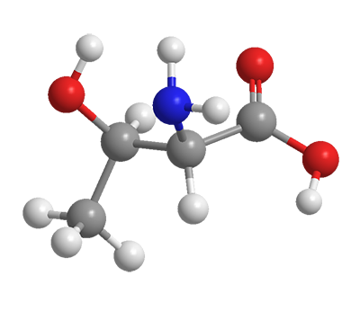
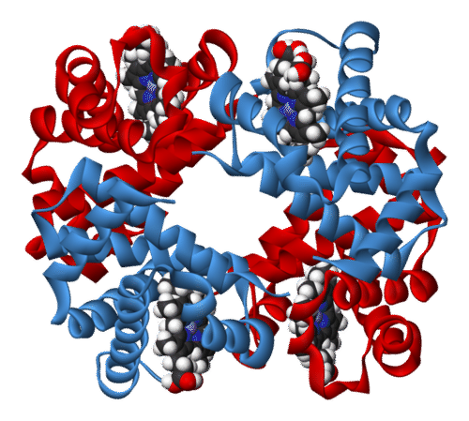
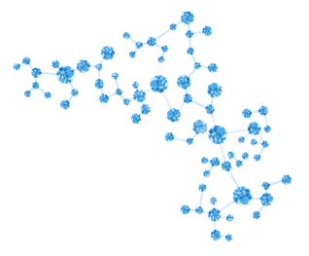
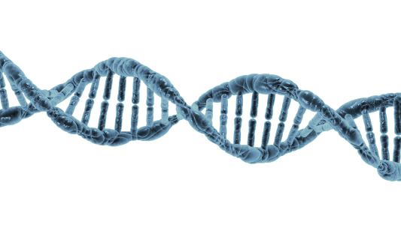
Bioinformaticians @ Vetsuisse
4.09.2018 Bern
Häfliger, Irene
Jagannathan, Vidhya Ritler, Dominic

Slide 2


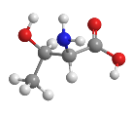
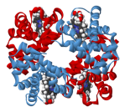
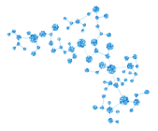
Bioinformaticians @ Vetsuisse
Irene
Institute of Genetics
Working field
Whole genome sequence analysis
Vidhya
Institute of Genetics
Working field
Transcriptomics
Whole genome sequence analysis
Dominic
Institute of Parasitology
Working field
Metabolomics
Proteomics
Transcriptomics

Slide 3
Bioinformaticians @ Vetsuisse
Who are you?

Slide 4
Bioinformaticians @ Vetsuisse
Goal:
Creating a platform for exchange between
bioinformaticians and persons working in the field
Create an interfaculty bioinformatics network
Share knowledge and experiences
Enhance bioinformatics knowledge at the Vetsuisse

Slide 5
Bioinformaticians @ Vetsuisse
Implementation:
Establish a Vetsuisse bioinformatics meeting
On a regular base
Work related discussions
Journal club
Including invited speakers

Slide 6
Bioinformaticians @ Vetsuisse
Questions and ideas:
What would you like to have exchange about?
How regular should we meet?
suggestion: next meeting 18th of September 3pm

Slide 7

Bioinformaticians @ Vetsuisse
The cake is no lie!

